Slide 1
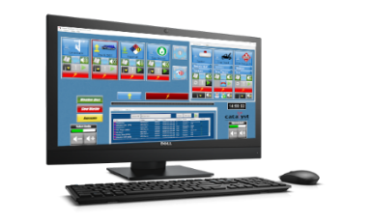



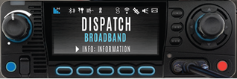


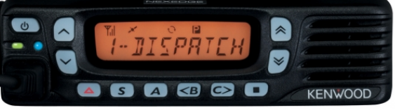
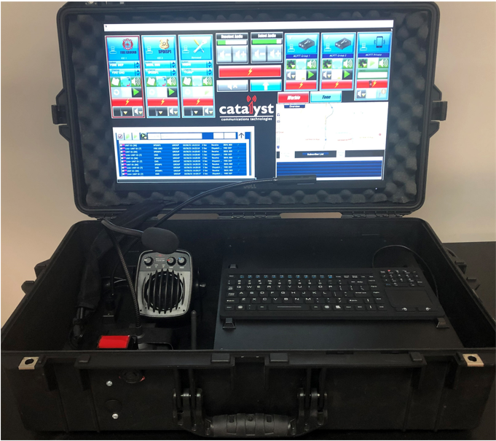
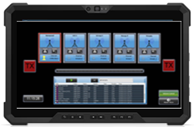
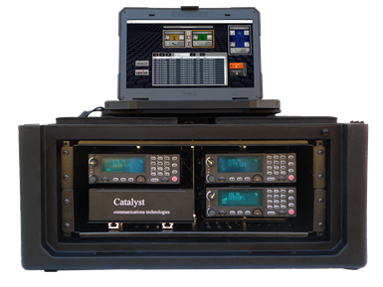

Catalyst Demonstration System Architecture
Propulsion™ LTE, LMR Console
L3Harris
XL200 Multi-band Mobile Radio
FirstNet PTT Users
FirstNet Network
P25 Portable Radios
MCPTT Server
Intelligent Connections
IntelliLink™
Interworking
LTE Router
SouthernLinc
Network
Kenwood Multi-mode Mobile Radio
MCPTT Server
Linc MCPTT Users
DMR, P25, NXDN Portable Radios
Tablet LMR-LTE
USER
GO-KIT with Propulsion™ Console
ICE™ with L3Harris Mobile Radios
Notes:
IWCE 2023 High Level Architecture – intended to be used as a tool for clients/prospect conversations

